Slide 1
Dynamic Properties of Objects
Define Me!

Slide 2
Objects
Objects are individual customized constructs built from templates.

Slide 3
Templates
A template defines the structure for the object, what information it contains and what tasks it can perform.

Slide 4
Templates
The programmer codes the template (often called a class).

Slide 5
Templates
Every object made from the template is comprised of the same information, stored in variables, and can perform the same tasks, written as functions.

Slide 6
HTML Elements
An HTML Element object is built from an HTML Element template. All HTML Elements have certain properties and tasks in common, though the values may differ.

Slide 7
HTML Elements
Every <div> and <span> has an innerHTML. When you have an object created, you can refer to the innerHTML (or any other property) by using the dot (.) operator.
object.property

Slide 8
HTML Elements
When you need to refer to the object from inside the template, or a part of the template, you refer to the object as this.
this.property

Slide 9
Dynamic Properties
While we don’t have access to templates we haven’t made, we can alter the mold of an object on the fly.

Slide 10
Transition
You should have completed an image gallery using this. Open that up now.

Slide 11
Image Gallery
Some of your code may differ, but you should essentially have the following…

Slide 12
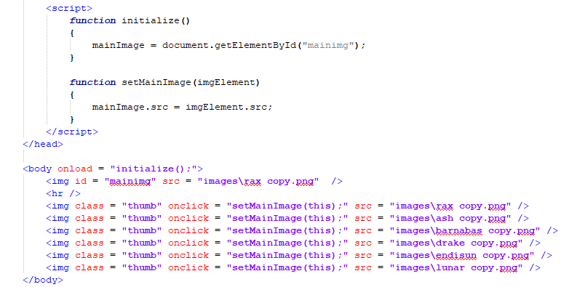
Image Gallery Code

Slide 13

The Caption
Let’s add a caption to the gallery. Every time the user clicks on a thumbnail, the large sized image will change and a caption with the dragon’s name will appear.

Slide 14
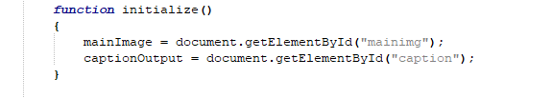
The caption
Let’s add a global variable to main so the caption element is represented.

Slide 15
The Caption
As with the image, we want to update the caption every time one of the thumbnails is clicked. We already have an onclick event programmed to call setMainImage(…).

Slide 16
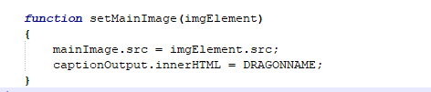
The Caption
Inside set main image, we use the passed object to set the src property of the main image. We will set the caption using the global variable we created.

Slide 17
The Caption
The real question is, “where does that DRAGONNAME come from”?

Slide 18
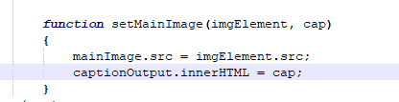
The Caption
This is where you use a parameter.

Slide 19
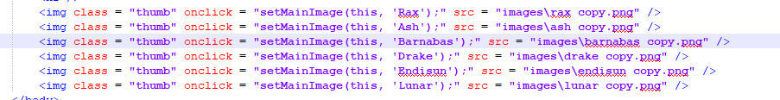
The Caption
Now we just need to pass in the proper values as arguments.

Slide 20
Back to Objects
What does any of this have to do with altering the mold?

Slide 21
Adding Properties
Our <div> tags have the innerHTML property. Our <img /> tags have the src property. What if the <img /> tags could also have a property that represents the name of the dragon?

Slide 22
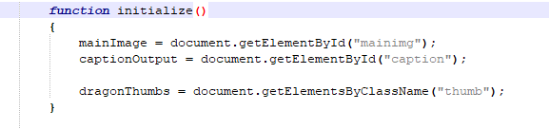
Adding Properties
Let’s first capture the thumbnail images in a list. We do this in initialize.

Slide 23
The HTML Element List
Every item in that dragonThumbs list is one of the <img /> elements. We can now add properties to each of those elements.

Slide 24
The dot (.) Operator
We’ve always used the dot (.) operator to access and update object properties. You can also use the dot operator to create properties for objects the same way you create new variables.

Slide 25
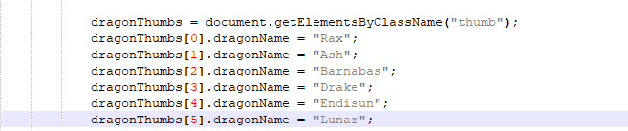
Adding The PRoperties
Let’s give a dragonName to each of the <img /> elements.

Slide 26

Accessing the new Properties
Now we no longer need the parameter…

Slide 27
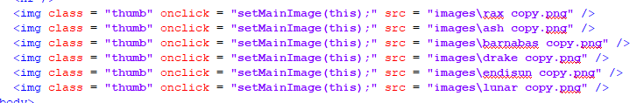
Accessing the New Properties
…which means we no longer need to pass the name into the function as an argument…

Slide 28
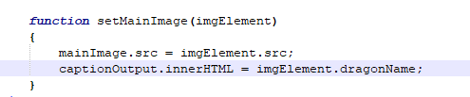
Accessing the New Properties
…because the name of the dragon is embedded in the <img /> element itself.

Slide 29
Dragon Activity
Included with this Powerpoint Presentation was a file called dragondata.js. That file includes a semi-colon delimited string of the dragon names and a semi-colon delimited string of some information about each dragon.
Incorporate the names and information into your image gallery so that the user sees both along with the image when a thumbnail is clicked.
Remember to use CSS to make it look nice.

